Slide 1
Kate Dickson Creative Heritage Consultants Ltd The role of the voluntary sector in heritage-led regeneration in the UK

Slide 2
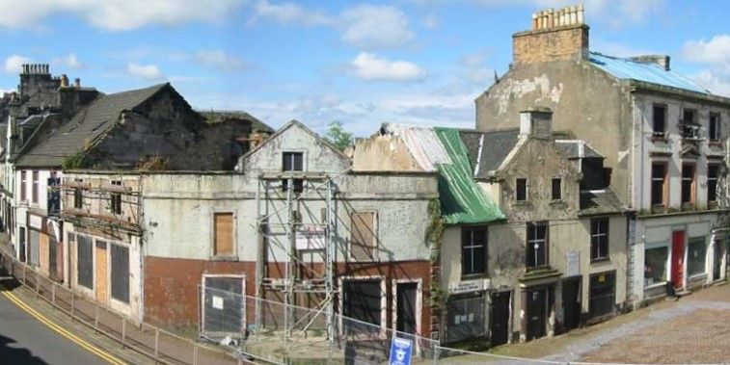
How do you turn this……
Beith, North Ayrshire, Scotland 1997

Slide 3
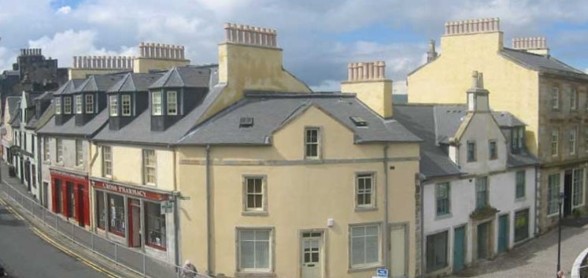
….into this?…..
Beith, North Ayrshire, Scotland 2004

Slide 4
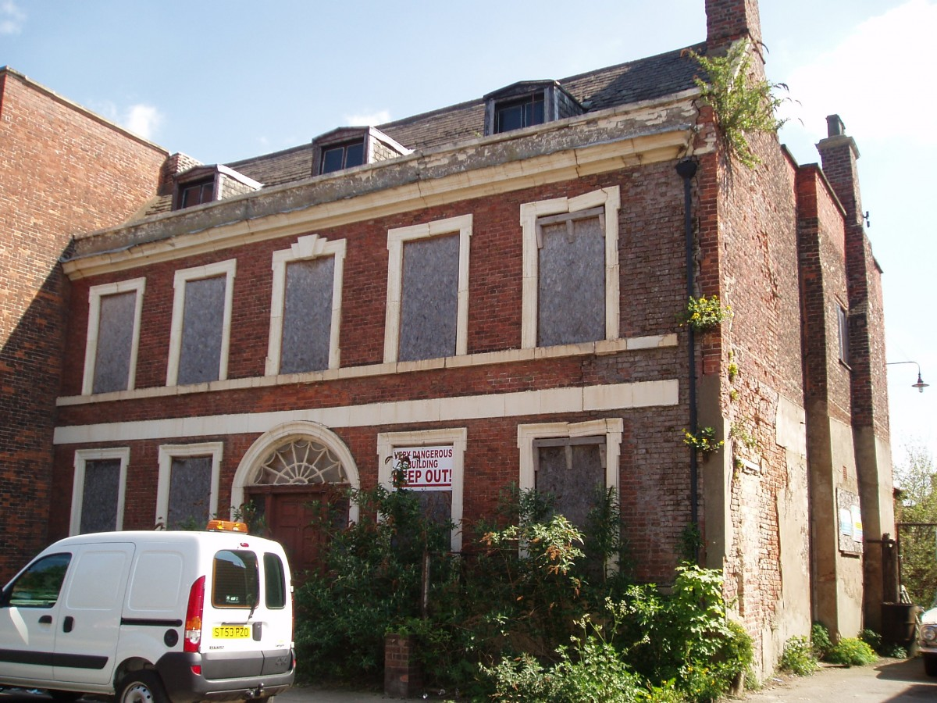
Or this……
16 High Street, Boston, Lincolnshire (2009)

Slide 5
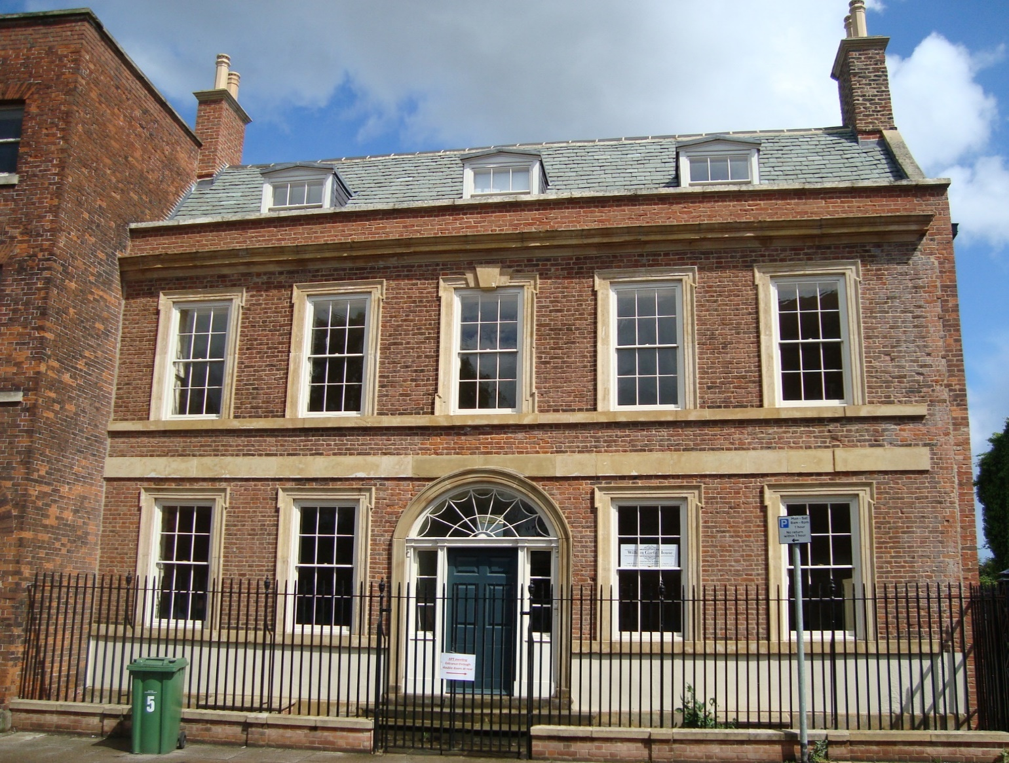
….into this……
16 High Street, Boston, Lincolnshire (2012)

Slide 6
Building Preservation Trusts
Charitable property developers
Managed by volunteers
Motivated by heritage & community, not profit
Can access grants to bridge the ‘conservation deficit’, especially Lottery & Trust funds
Traditionally tackle historic buildings at risk that are ‘beyond market forces’
Notes:
Often described as ‘developers of last resort’

Slide 7
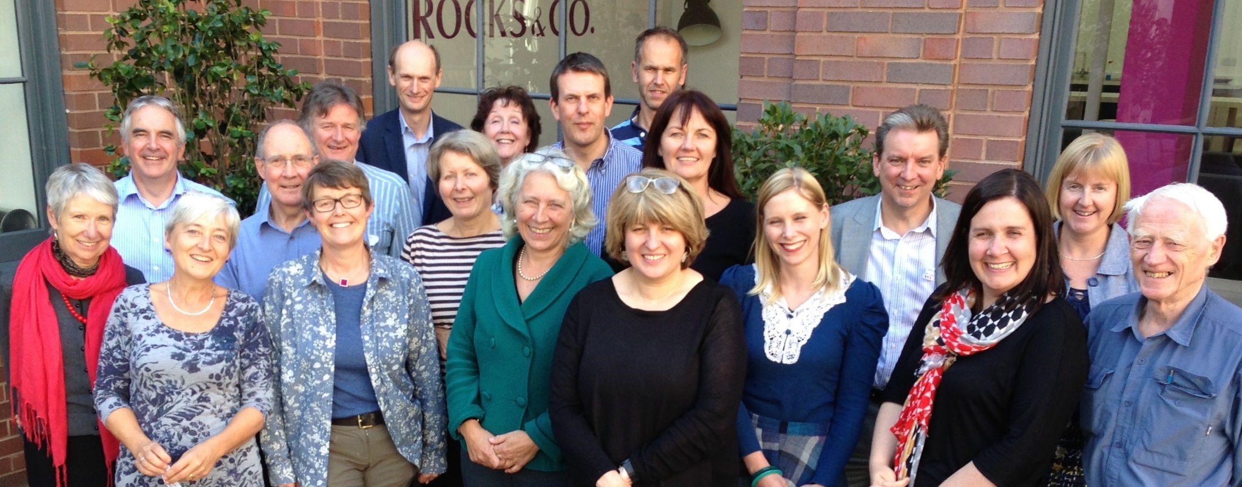
Heritage Trust Network
Notes:
HTN Trustees and regional representatives at a national gathering (not very diverse – we need to work on that)

Slide 8
Heritage Trust Network
Over 200 Trusts in the UK
Small percentage have paid staff
Wide range of building types
End uses for community benefit
Network provides peer support & advice
Conferences and regional meetings
‘Pool’ of professional advisers
Notes:
End uses: community hub, meeting rooms, crèche & after school clubs, office space for start up businesses, creative arts studios, well-being centres
Advisers in the ‘pool’: VAT, governance, business planning

Slide 9
Typical Trust characteristics
Unpaid Trustees
Often retired or have plenty of time
Architect, planner, lawyer, accountant
Passionate and visionary
Campaigning
Able to make a case
“Voluntary nor amateur”
Notes:
Skills need on the Board change over time. Start off with visionary, campaigning people, then you need fundraisers who can write funding applications, then project managers & decision makers who can deleiver projects.

Slide 10
Ancoats Buildings Preservation Trust
Established 1995…..
Notes:
I want to talk about one particular building preservation trust, which I ran (as paid director) for 12 years

Slide 11
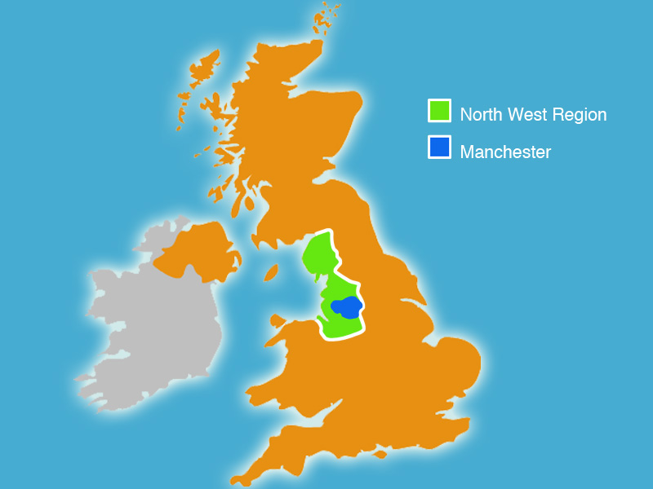
Manchester, UK
Notes:
Location – Manchester is the principal city of the North West of England

Slide 12
Manchester United!
Notes:
Everyone has heard of Manchester United!

Slide 13
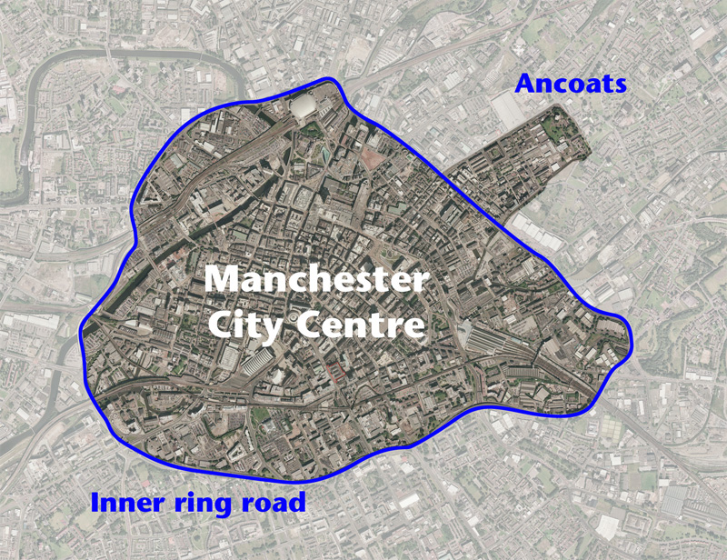
Ancoats, Manchester
Notes:
Ancoats lies just to the north east of the city centre, just outside the inner ring road that once formed the city boundary,
Part of the area now known as New East Manchester, which was the focus for the Commonwealth Games in 2002

Slide 14
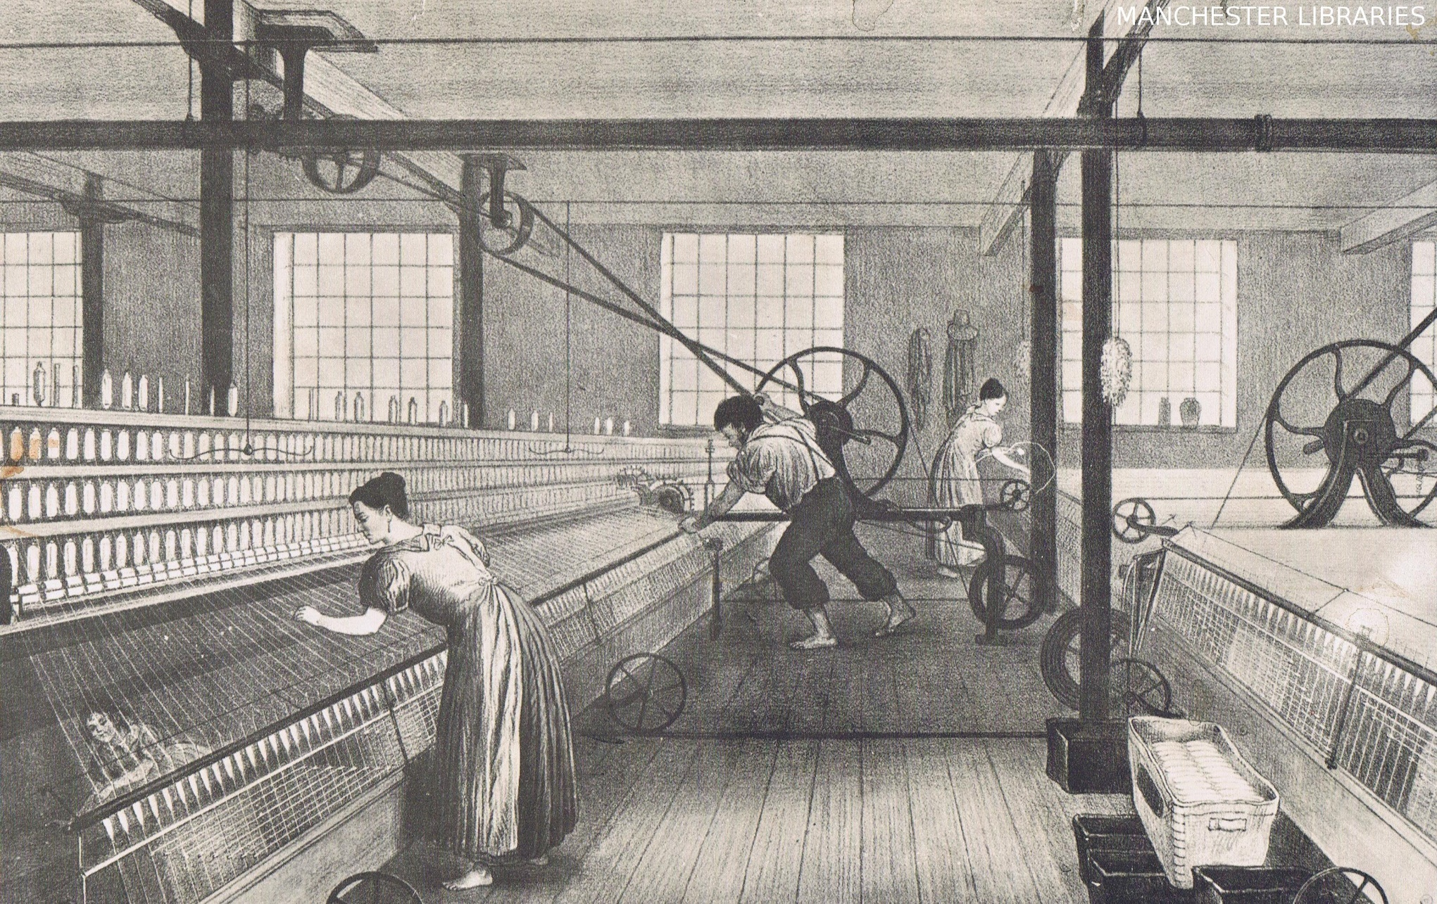
Britain’s role in the Industrial Revolution
Notes:
UK can rightly claim to be the birthplace of the International Industrial Revolution, due to:
Existence of raw materials, ready workforce flocking in from agricultural areas
Inventions from development of cast iron to textile machinery and railways
Entrepreneurism; Free Trade; the British Empire

Slide 15
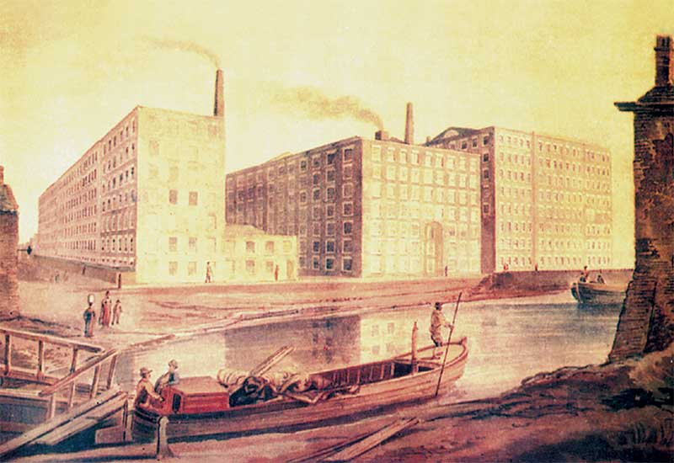
The mill wall of Ancoats
18th century watercolour
Notes:
Classic image of Ancoats – mills forming a wall along the edge of the canal

Slide 16
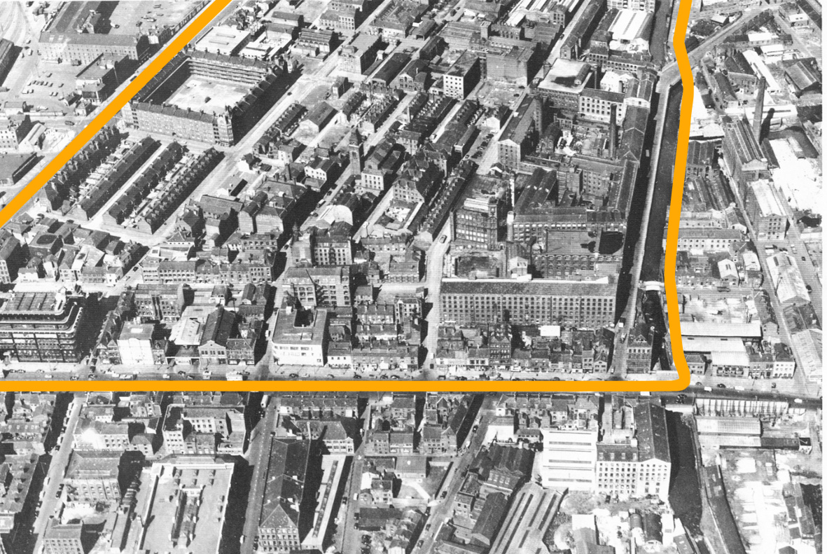
Ancoats in the 1960s
Notes:
Photo taken on the brink of the decline in Ancoats
Mills and industrial buildings on the right hand side, by the canal
Municipal housing estates on the left hand side
Central area: buildings for small businesses, pubs, schools, churches and terraces of workers’ housing

Slide 17
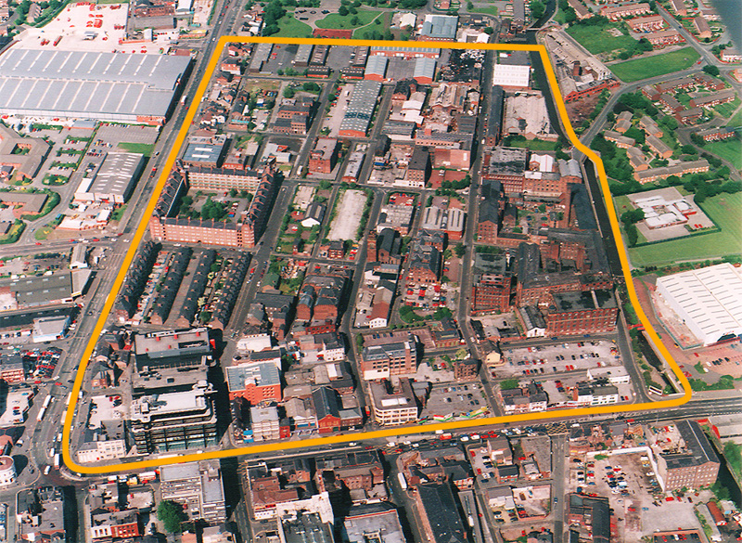
Ancoats in the 1990s
Notes:
Council housing remains on the left side and most of the mills remain on the right
Green areas indicate where most of the housing terraces have been demolished and replaced with landscaped car parks!
The ‘Ancoats Group’ formed in the 1980s to campaign about the plight of the Ancoats mills
Ancoats designated as a Conservation area in 1989
13 buildings are listed – eight of them at grade II* (thus in the top 10% of listed buildings in the country)

Slide 18
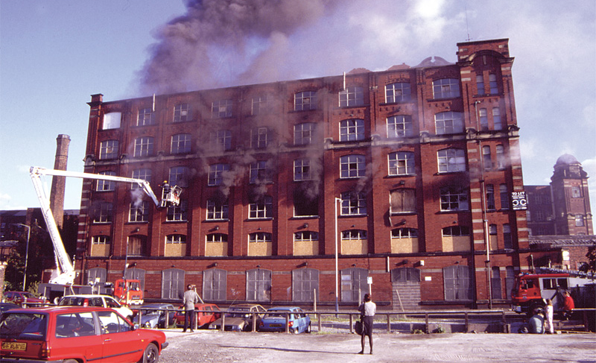
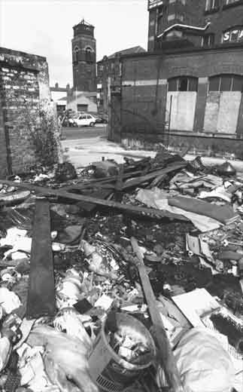
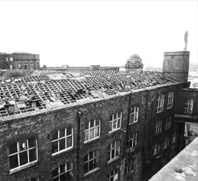
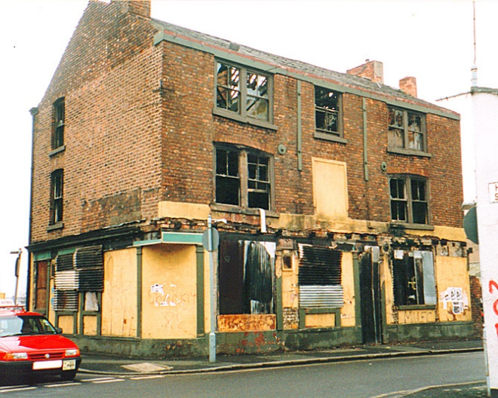
Images of Ancoats in 1996
Notes:
Closer up, massive social problems
Historic buildings legislation doesn’t protect against the weather, pigeons and arsonists

Slide 19
Partnerships: complementary regeneration organisations
Eastside Regeneration programme:
community safety, training, childcare
Ancoats Buildings Preservation Trust: protection & reuse of heritage buildings
Ancoats Urban Village Company: to attract private sector investment in new buildings, & public funding for infrastructure
North West Regional Development Agency: extensive property purchase powers
Notes:
Eastside Regeneration – established by Manchester City Council, but ‘arms length’
BPT – shared offices with Eastside Regen & Ancoats UVC (until they merged into New East Manchester Ltd)
RDA – established by national government; well-funded organization, able to invest in private development to kickstart economic regeneration. Abolished in 2012

Slide 20
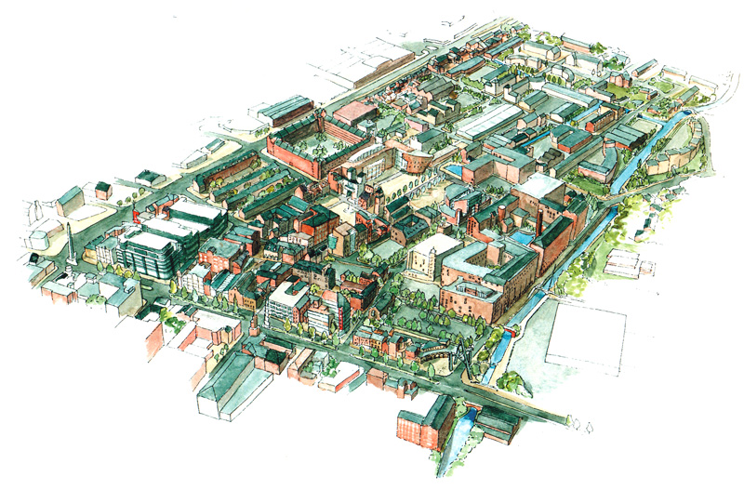
Shared vision for the new Ancoats (‘Little Italy’)
Notes:
Shared vision on Urban Village principles- rekindling image of a lively place where people would want to live and work, with cafes and street life. Bit romantic and architecturally twee, but popular with the local community

Slide 21
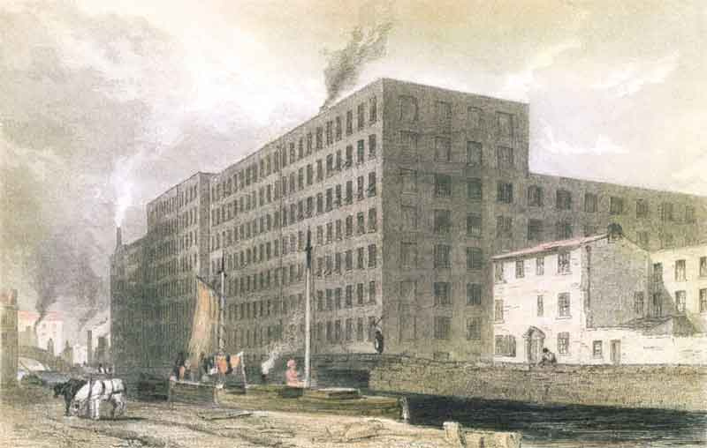
Murrays’ Mills – built 1798
Notes:
Another classic Ancoats image: mills along Rochdale Canal
Murrays’ Mills in centre of picture – note the chimney smoking
To the left is the Royal Mills Complex

Slide 22
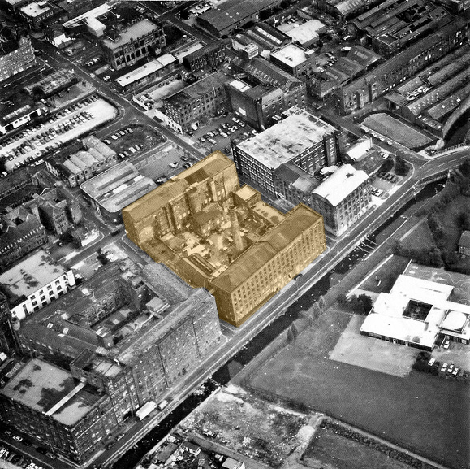
Murrays’ Mills – 1980s
Notes:
Grade II* listed, 200 year old complex
Purpose built to use steam power to drive machinery – earliest remaining example

Slide 23
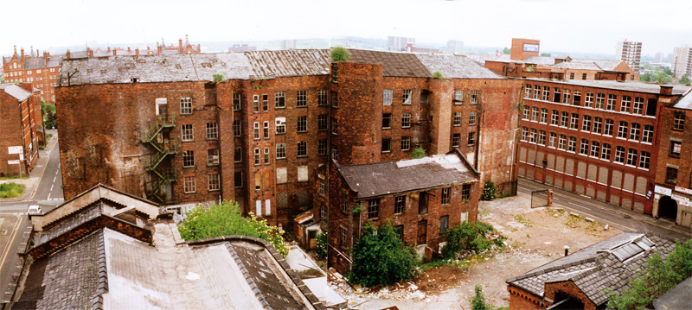
Murrays’ Mills
Courtyard view in 1995
Notes:
Photo taken after demolition of Bengal St preparation wing following a small fire in the mid 1990s
Murrays’ Mills in serious decline since cotton spinning ceased in the 1950s
Converted into small units for textile-related businesses and storage
Low rents & slim profit margins led to a lack of maintenance
Always frail, suffered structural failures, vandalism, rain penetration etc

Slide 24
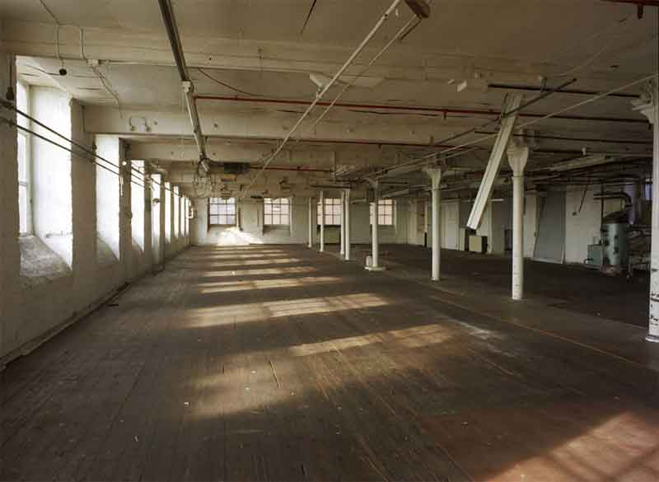
Murrays’ Mills
Typical interior, after clearance, 2003
Notes:
Typical interior of one of the last parts of the building to be in use

Slide 25
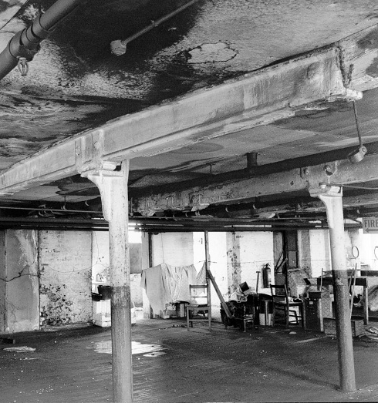
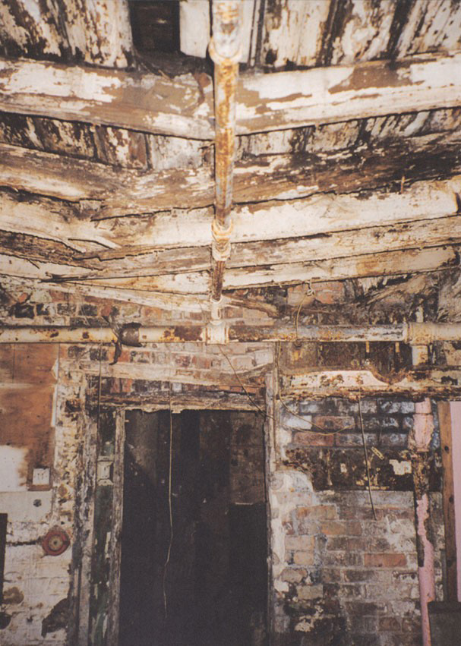
Structure & fabric: condition issues
Notes:
Other parts of the building told a different story….
Internal structure
Left: Cast iron columns – building reconfigured in 19th century - now has single row of columns in place of original two rows.
Right: Timber beams and joists – severe damp penetration and rot. Lath and plaster ceilings with tin sheet under-drawing for fire resistance – collapsed in many places

Slide 26
Public support for Murrays’ Mills
Lottery ‘grant in principle’ in August 2000
Regional Development Agency used CPO powers to secure ownership
Buildings passed to the Trust on a long lease
Public funding of £11.8m raised (Lottery & RDA)
Shell repair works on site 2005-06

Slide 27
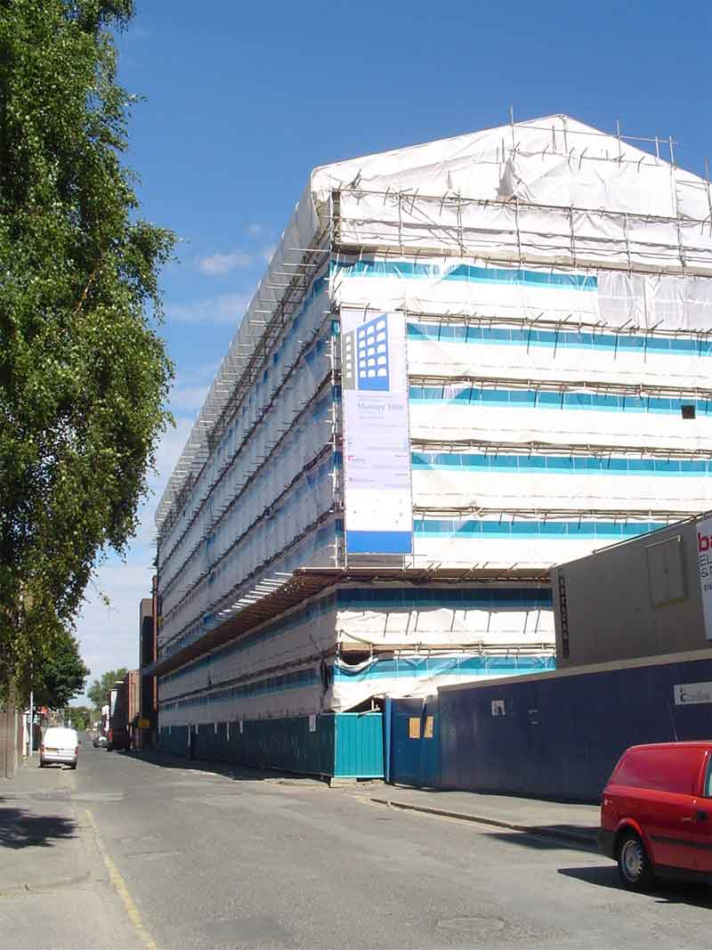
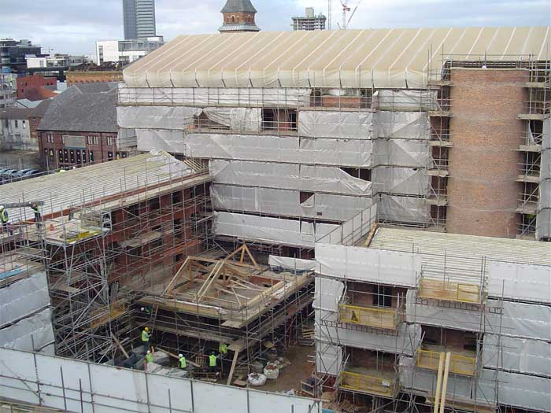
Murrays’ Mills on site in 2005 (1)
Notes:
First £1m was spent on scaffolding

Slide 28
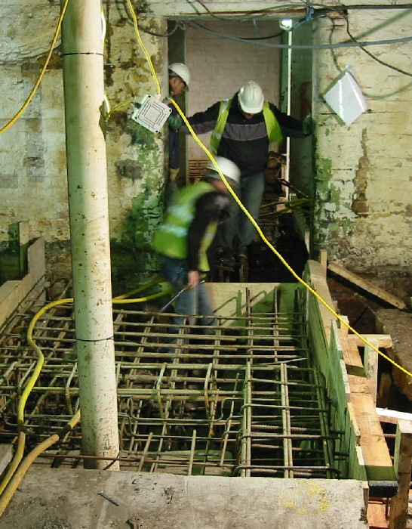
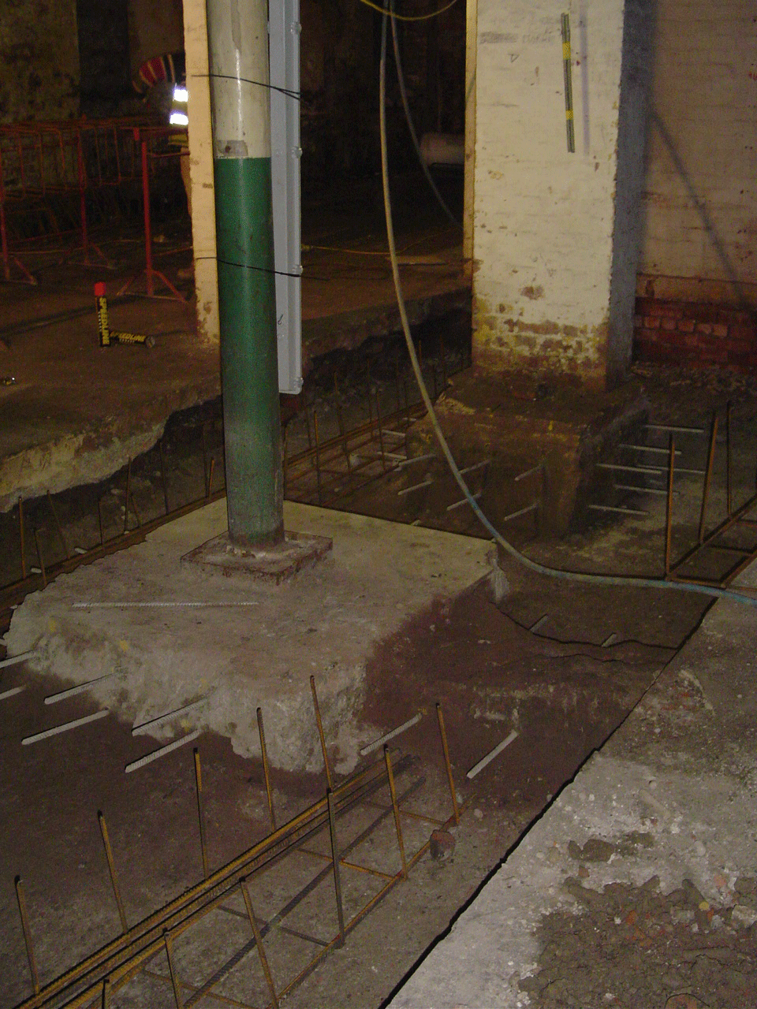
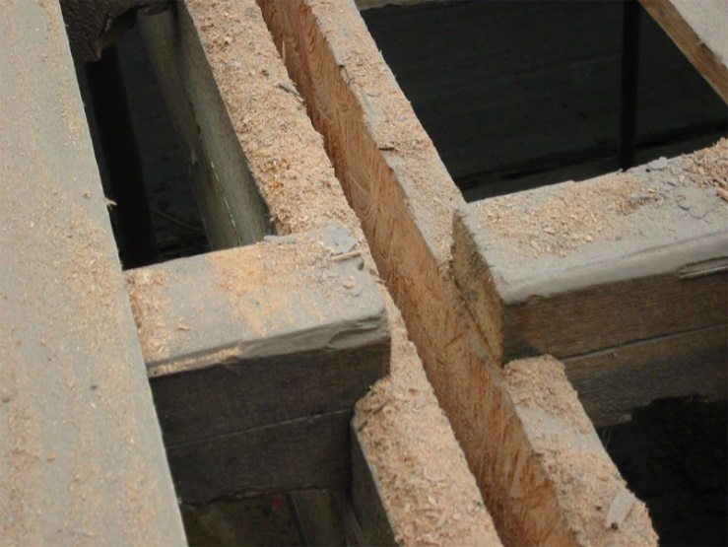
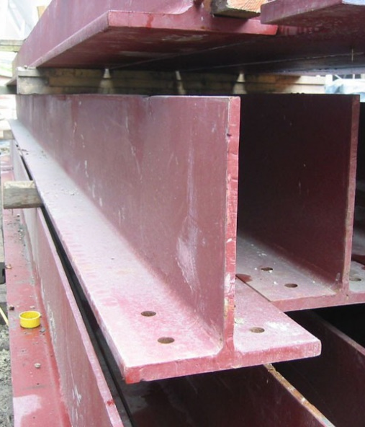
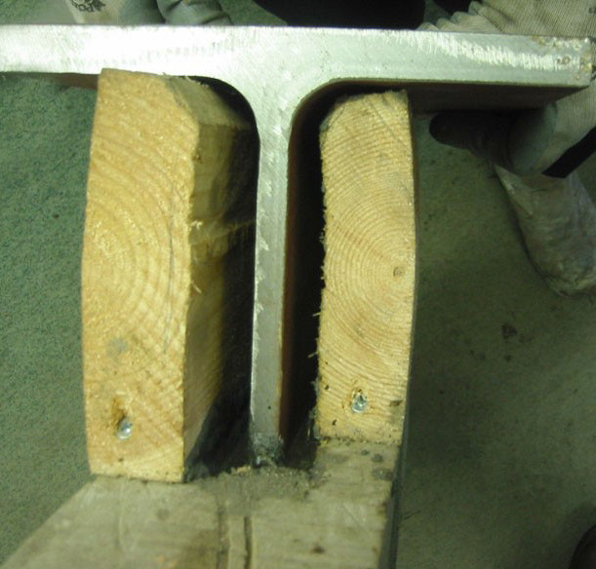
Murrays’ Mills on site in 2005 (2)
Notes:
Structural strengthening of floors for new uses.
Splicing in T beams to supplement historic structure, which was retained, carrying as much load as it safely can

Slide 29
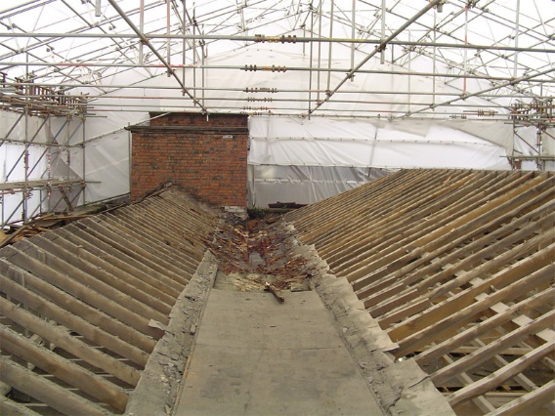
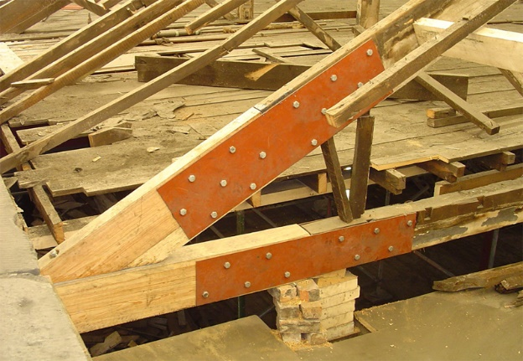
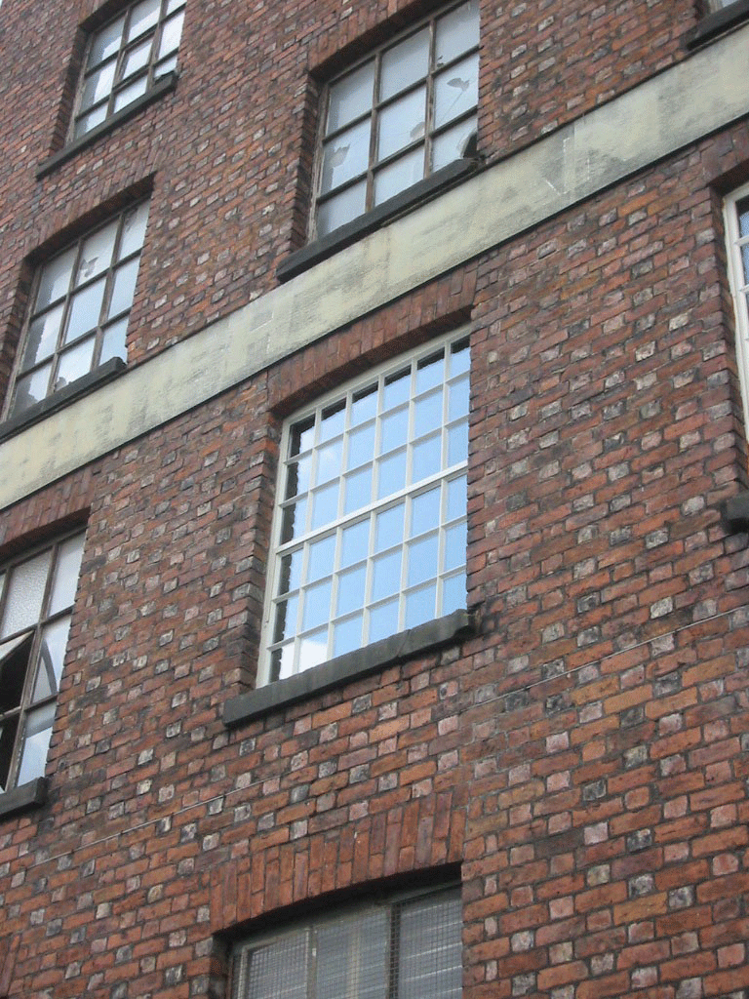
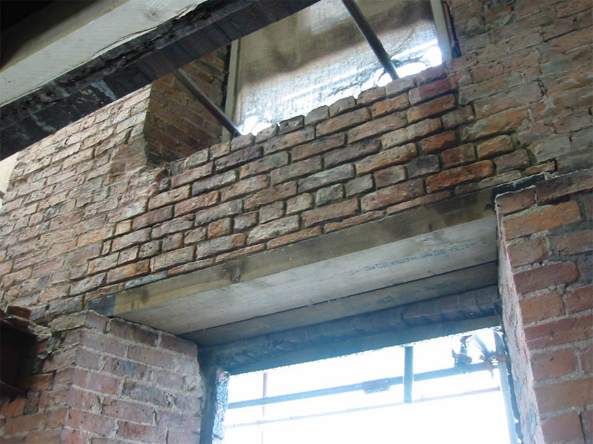
Murrays’ Mills on site in 2005 (3)
Notes:
Timber truss end repairs, re-covering the roofs, masonry repairs, replacing ritten timber lintels with new timber lintels 9and rebuilding the brickwork over them)
Best conservation practice

Slide 30
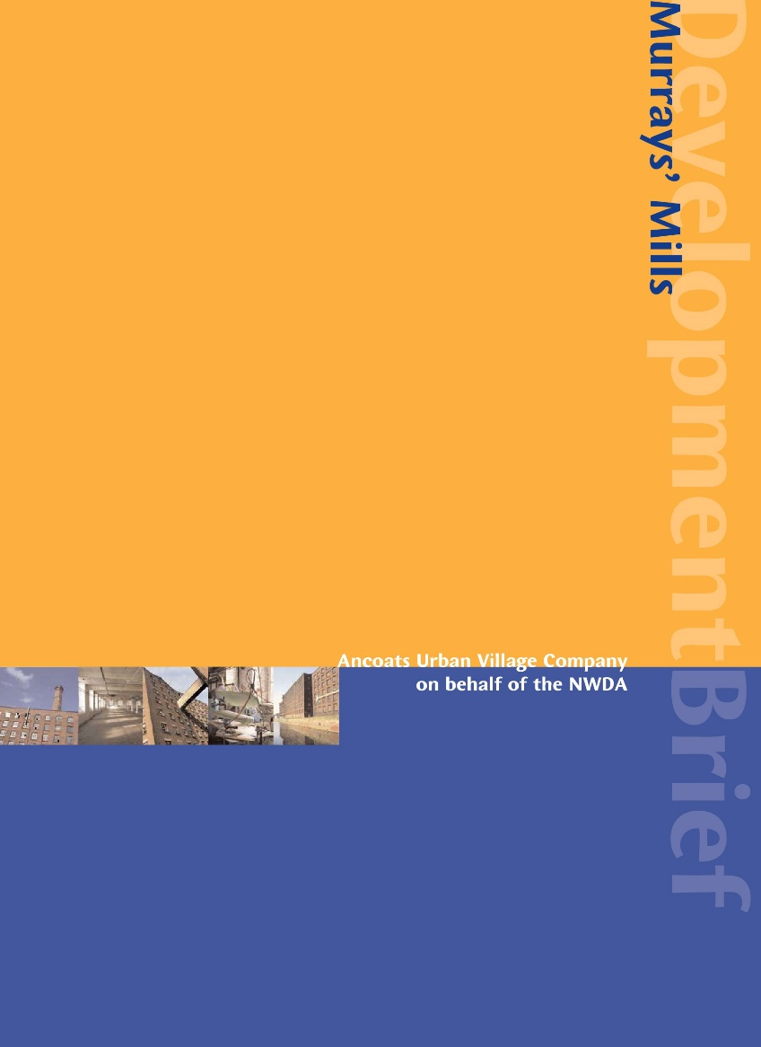
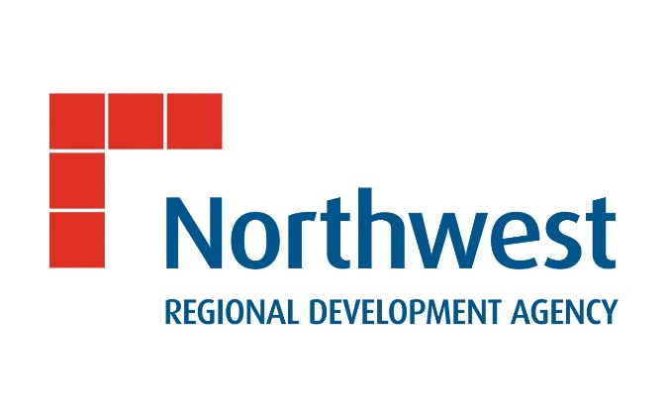
Murrays’ Mills Development Brief
Notes:
Meanwhile, AUVC and NWDA undertook a competition to select a private developer to take on the repaired buildings, to convert to a mix of uses 9not just residential) in accordance with a development brief.

Slide 31
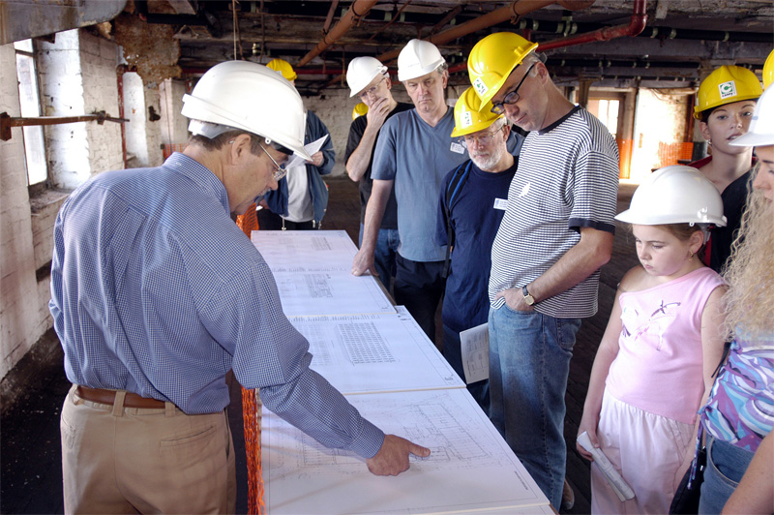
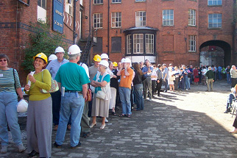
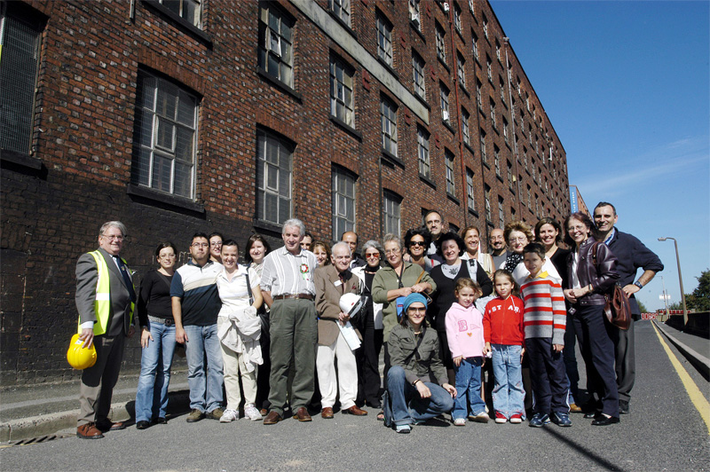
Engaging with the community
Notes:
Meanwhile the BPT also focussed on involving local people in regeneration - making the heritage asset intellectually and physically accessible
Annual Open Days – pictures from September 2003 and September 2004

Slide 32
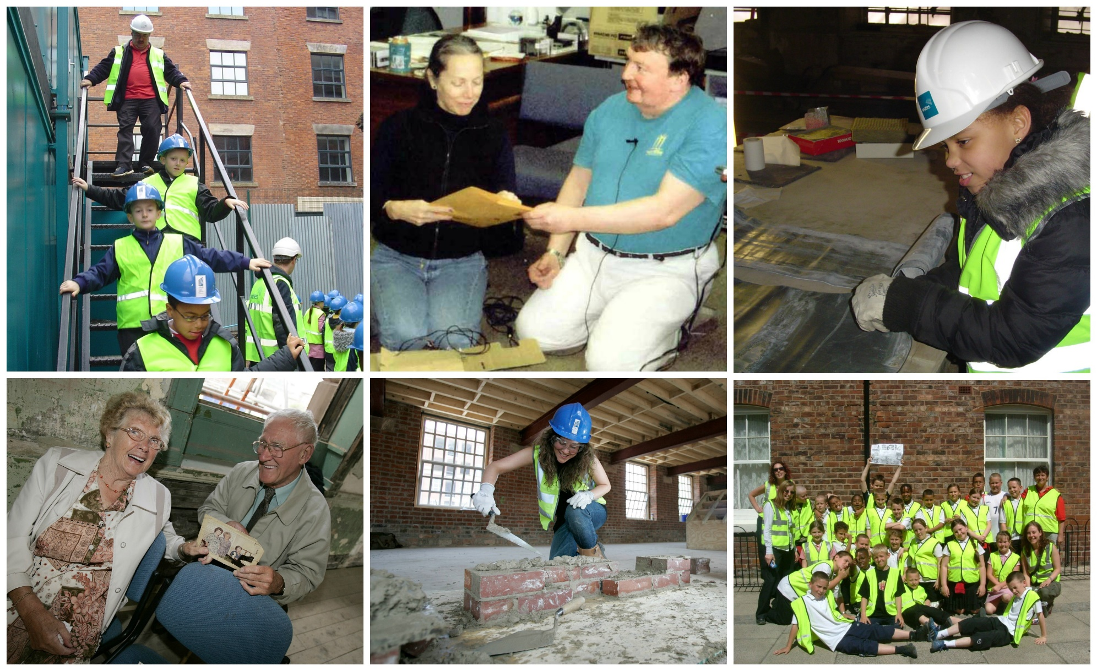
Skills, Schools & Stories
Notes:
Skills, Schools & Stories was separately funded by the Heritage Lottery Fund and charitable trusts, to formalise community engagement:
Conservation skills taster days for college construction students
Site visits and classroom activities for 8 – 10 year olds
Oral history recordings by trained volunteers, with older people sharing memories and photos which were published in a ‘scrapbook of Ancoats’

Slide 33
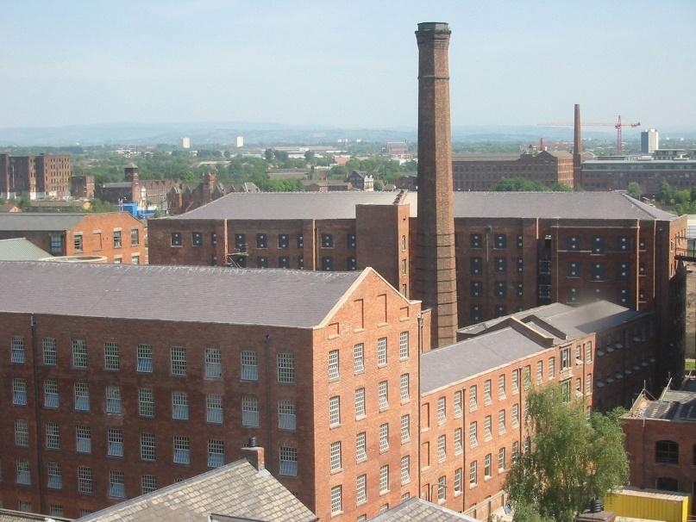
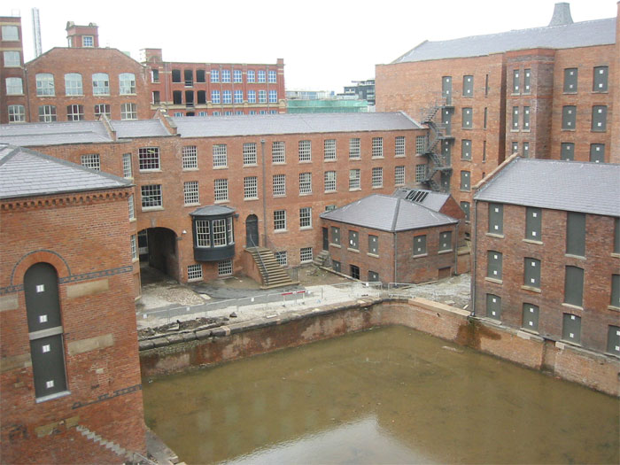
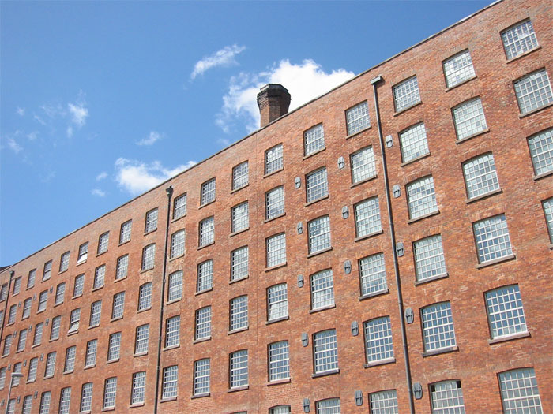
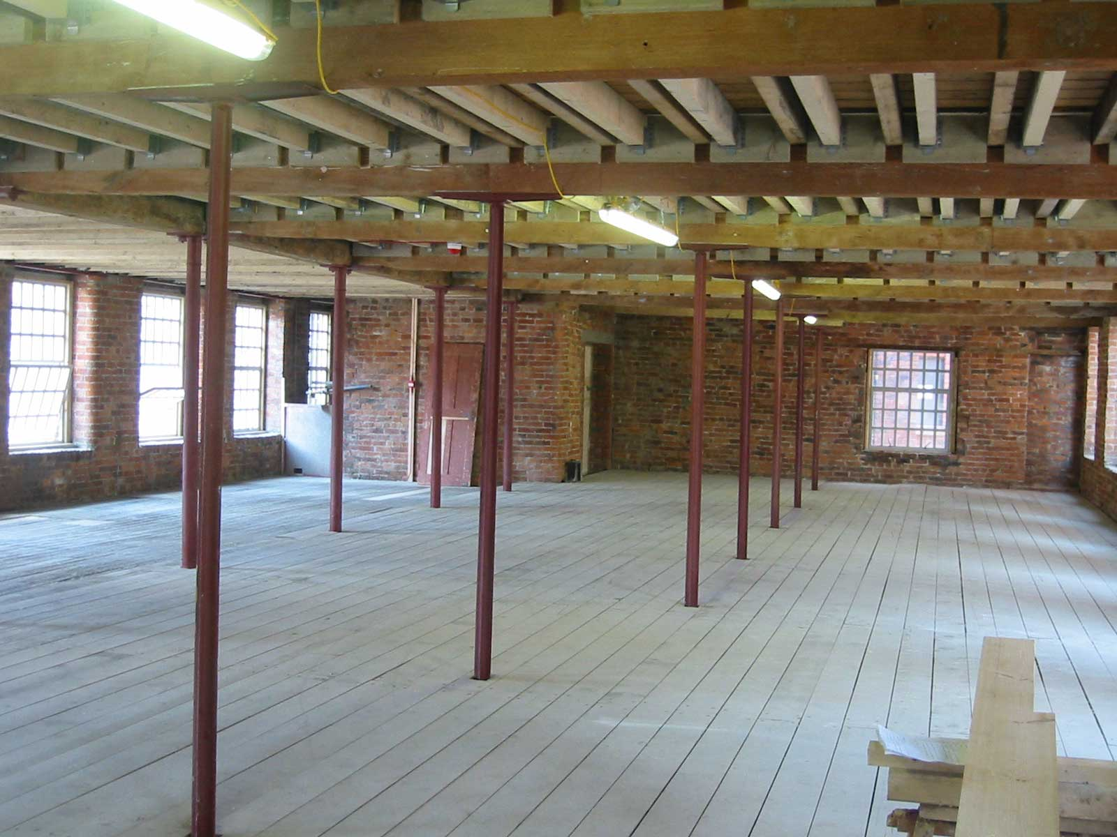
Murrays’ Mills 2006
Notes:
And this is the complex when we had finished the repair work, ready to hand on to the selected developer….but…

Slide 34
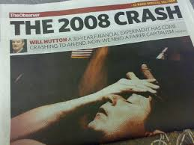
Then this happened….
Notes:
The preferred developer lost his bank finance and the whole Ancoats project went on hold….

Slide 35
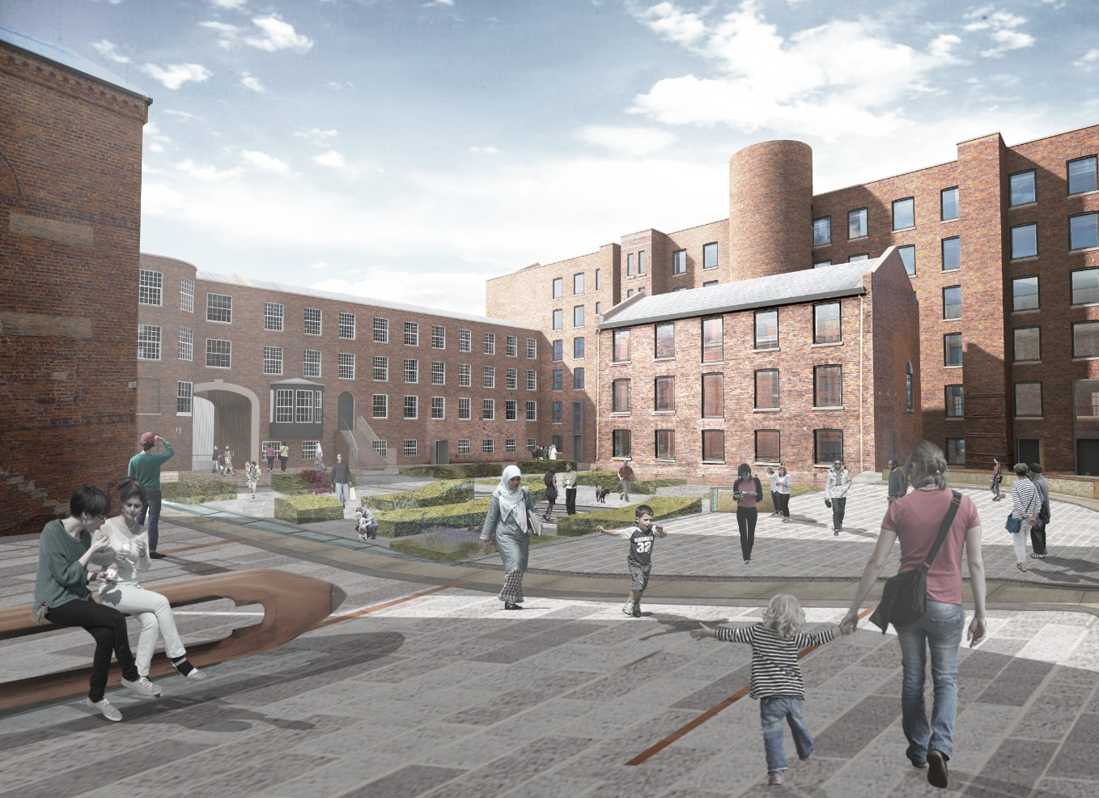
But ten years on….
Notes:
A new developer is now on site, creating a residential development
He is infilling the canal basin, because the scheme needs more amenity space for residents

Slide 36
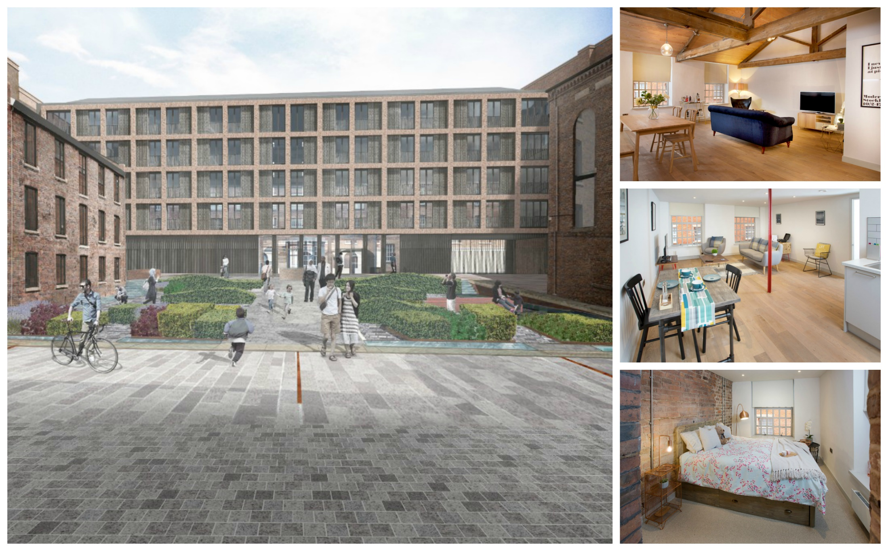
Development by Manchester Life
Notes:
And re-building the 4th side of the courtyard in a contemporary style.
Show flats have already been created in the Murray Street wing, to get pre-sales to fund the development

Slide 37
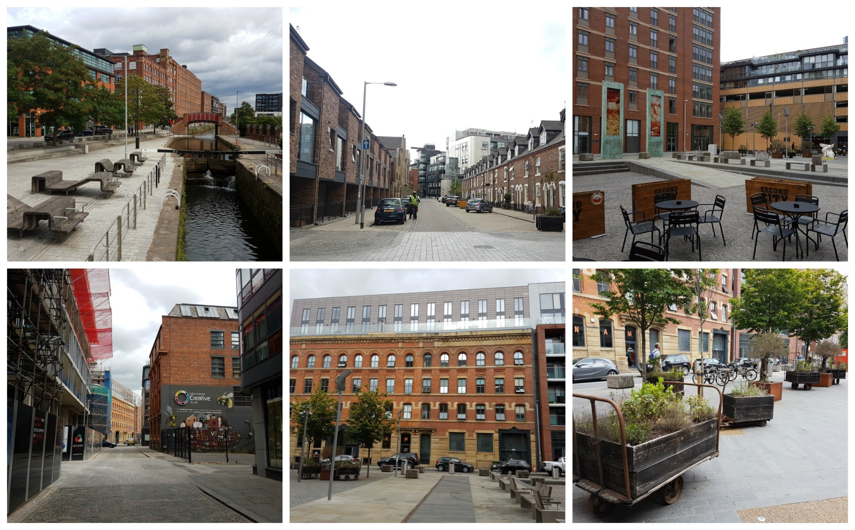
Ancoats 2018: Plenty of work for architects!
Notes:
And all around Murrays’ Mills, Ancoats is buzzing. New developments, some re-using old buildings (some more sensitive than others), open squares, café culture.
Murrays’ Mills has been a catalyst that has encouraged others to invest – both initially back in 2005, when some developments were completed before the recession, and again more recently, as the economy has picked up.
It has taken over 20 years – but it has created plenty of work for architects!

Slide 38
Lessons learnt
Regeneration takes a very long time!
Partnership delivery is key
Private, public & voluntary sectors
Risk assigned to those best placed to carry it
Community engagement and ‘buy in’
Leadership:
“One person with a passion is better than 40 who are merely interested!”

Slide 39
Thank you!
www.creative-heritage.net

